Slide 1
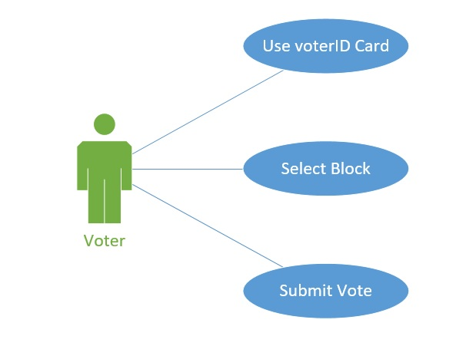
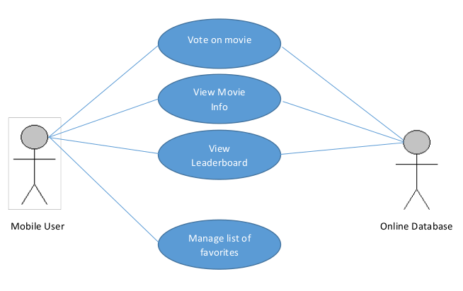
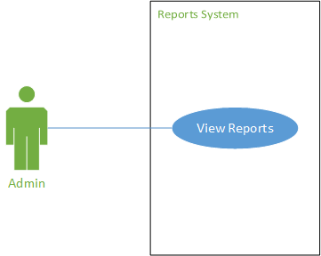
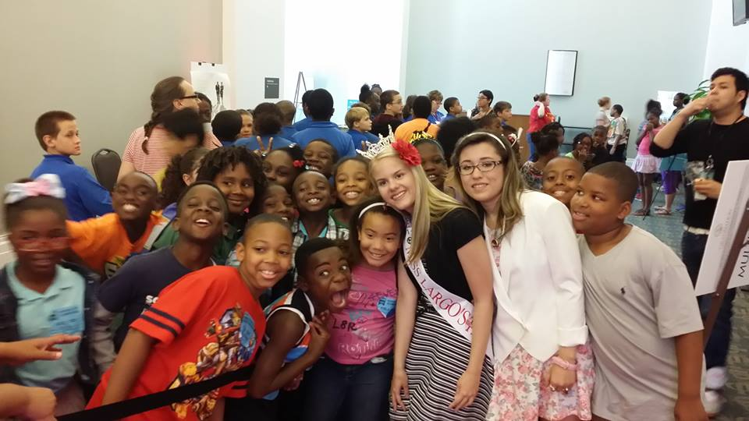
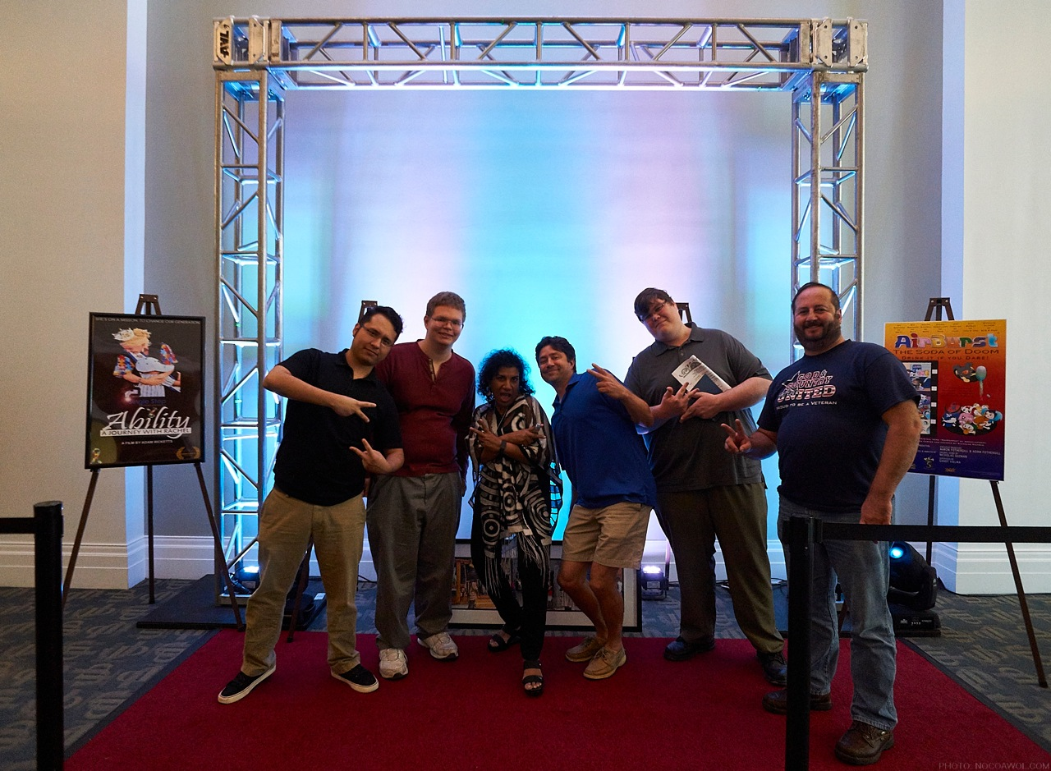
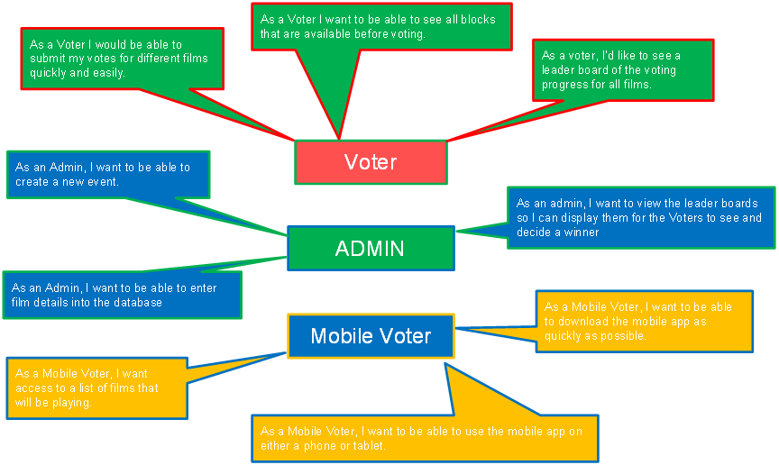
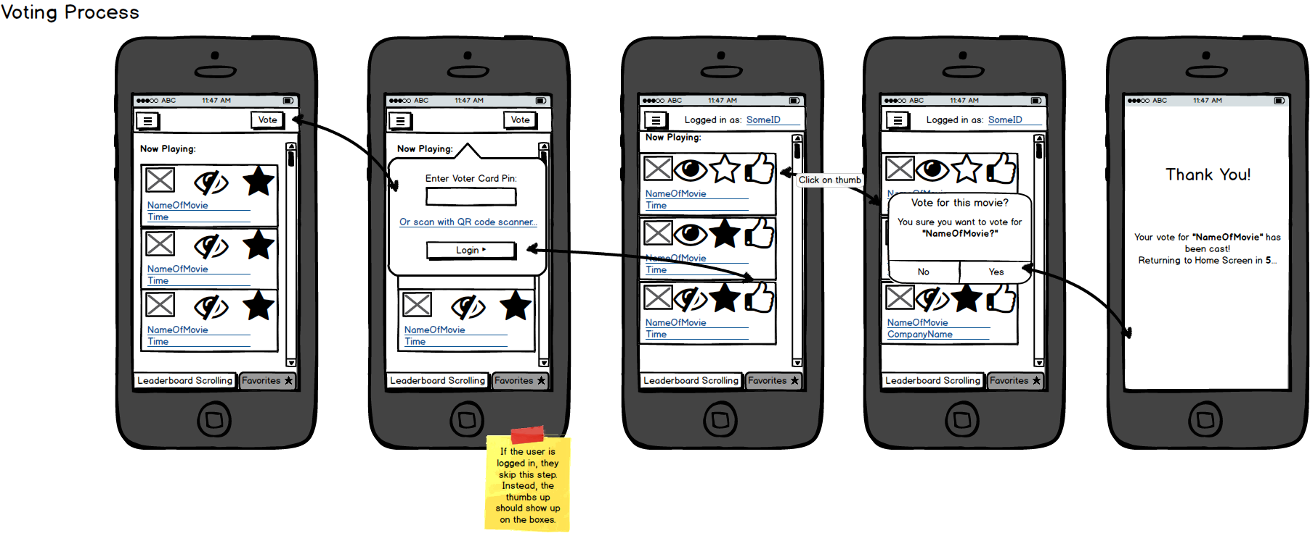









World Film Festival e-Voting System
Full name, ECT
University of North Florida, College Jacksonville, FL USA 32224
WORLD ART FILM FESTIVAL
DEVELOPMENT APPROACHES
SUMMARY
Next year 5,000 attendees are expected to benefit from participating in the World Arts Film Festival including college-aged students, local and visiting filmmakers from over 30+ countries, men and women from Jacksonville area, New York and California, groups, families and individuals including those with special needs interested in the unique film festival experience.
USER STORIES
FUTURE
In our e-Voting System we have accumulated roughly 40 different use r stories so far. All of these user stories revolves around 3 actors; Voter, Admin, Mobile Voter. Below is a snippet of just a couple of the user stories we came up with.
MOBILE DEVELOPMENT

